Slide 1
A Mechine Learning Approach for predicting Customer Churn in the Telecom Industry

Slide 2
Objectives of the Study
To perform exploratory data analysis (EDA) to understand customer behavior and identify patterns associated with telecom customer churn.
To develop and train multiple machine learning classification models for predicting customer churn basedon customer demographic, service usage, and billing information.
To evaluate and compare model performance before and after class balancing using training and testing accuracy along with standard classification metrics.
To enhance model performance through hyperparameter tuning and analyze its impact on prediction accuracy and model generalization.
To identify the most effective predictive model for telecom customer churn by comparing results across different algorithms and optimization stages.

Slide 3
Customer Churn
Customer churn means when a customer stops using the company’s service (switches to another network or cancels the connection).
In telecom:
Churn = customer leaves the network
No churn = customer stays with the network
Customer churn is a major challenge in the telecom industry due to intense competition and low switching costs.
Predicting churn in advance helps telecom companies identify customers who are likely to leave and take proactive retention actions.
This improves customer satisfaction and reduces revenue loss

Slide 4
Data Overview
Source of Dataset: Kaggle
Type of Data: Secondary Data
No of rows: 7043
No of columns: 21columns
Each row represent one customer and each column represent each variables
Target variable: Churn (Yes/No)

Slide 5
Explanation of Variables
(A)Customer personal details
These describe demographic characteristics.
customerID – Unique ID for each customer
gender – Male / Female
SeniorCitizen – 1 = senior citizen, 0 = not
Partner – Whether customer has a partner
Dependents – Whether customer has dependents
(B)Contract and billing information
These describe the financial and contract behavior of customers.
Contract – Month-to-month / One year / Two year
PaperlessBilling – Yes / No
PaymentMethod – Electronic check / Bank transfer / Credit card / Mailed check
MonthlyCharges – Monthly bill amount
TotalCharges – Total amount paid
tenure – Number of months the customer has stayed

Slide 6
(C) Service-related variables
These show what services the customer is using.
PhoneService – Has phone service or not
MultipleLines – Has multiple phone lines or not
InternetService – DSL / Fiber optic / No
OnlineSecurity – Yes / No
OnlineBackup – Yes / No
DeviceProtection – Yes / No
TechSupport – Yes / No
StreamingTV – Yes / No
StreamingMovies – Yes / No
(D) Target variable
Churn –Yes → Customer left
No → Customer stayed

Slide 7
EDA

Slide 8
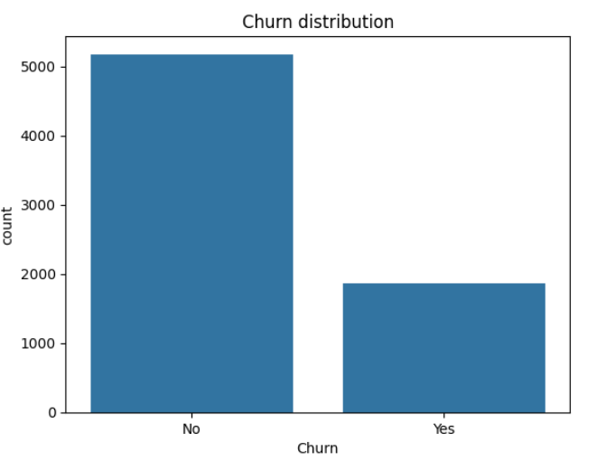
Target Variable Distribution

Slide 9
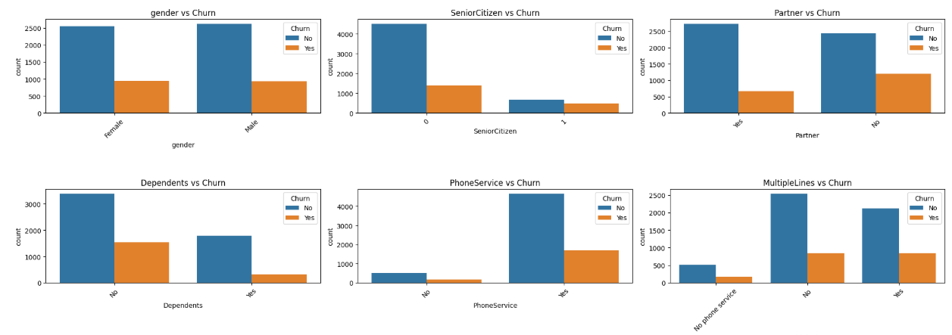
Categorical features vs Churn

Slide 10

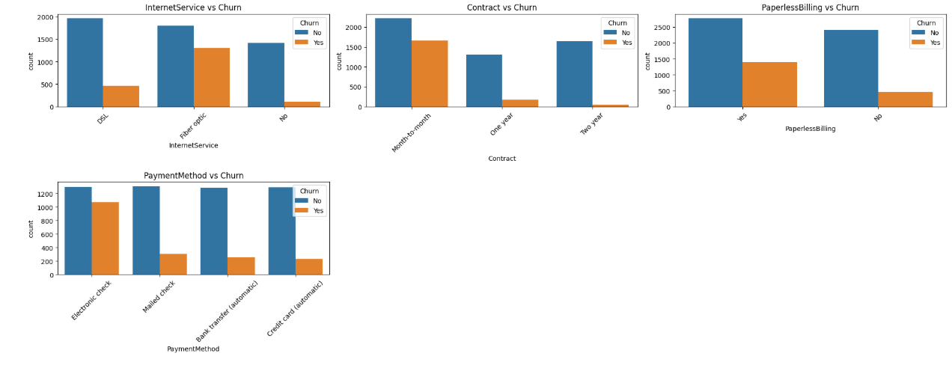

Slide 11
Gender: Churn is almost equal for males and females, so gender does not significantly influence churn.
Senior Citizen: Senior citizens have higher churn because they may find telecom services costly or difficult to manage.
Partner: Customers without a partner churn more because they have fewer family commitments to keep the service.
Dependents: Customers without dependents show higher churn since they are more flexible to switch providers.
Phone Service: Customers with phone service show more churn because most users belong to this category.

Slide 12
Multiple Lines: Customers with multiple lines have slightly higher churn because higher service cost may lead them to switch providers.
Internet Service: Fiber optic users have the highest churn because it is more expensive compared to DSL.
Contract: Month-to-month contract customers have the highest churn because they are not bound by long-term agreements.
Paperless Billing: Customers using paperless billing show higher churn since these customers are more comfortable switching services online.
Payment Method: Customers using electronic check show the highest churn because this method is commonly used by short-term customers.

Slide 13
Online Security: Customers without online security churn more because they feel the service is less secure.
Online Backup: Customers without online backup show higher churn since they receive fewer value-added services.
Device Protection: Customers without device protection churn more because they may feel their devices are not well supported.
Tech Support: Customers without tech support show higher churn due to lack of assistance when issues occur.
Streaming TV: Customers without Streaming TV show higher churn because they are not using additional entertainment services, so they feel less value from the telecom plan.
Streaming Movies: Customers without Streaming Movies have higher churn since they are less engaged with bundled digital services offered by the company.

Slide 14
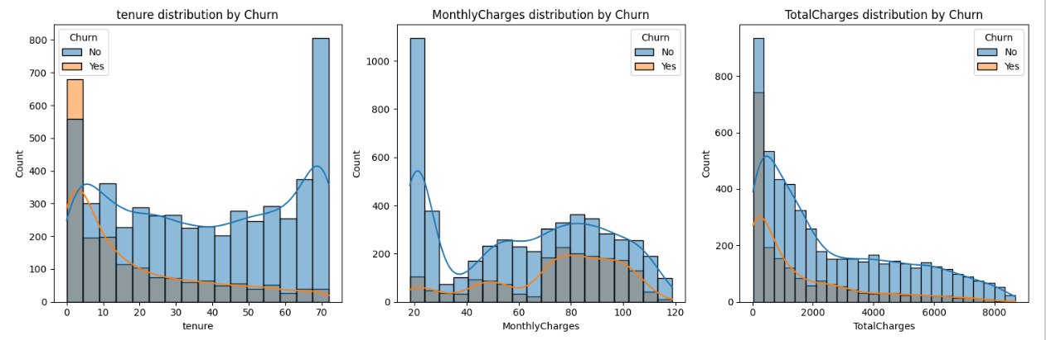
Neumerical Features vs Churn

Slide 15
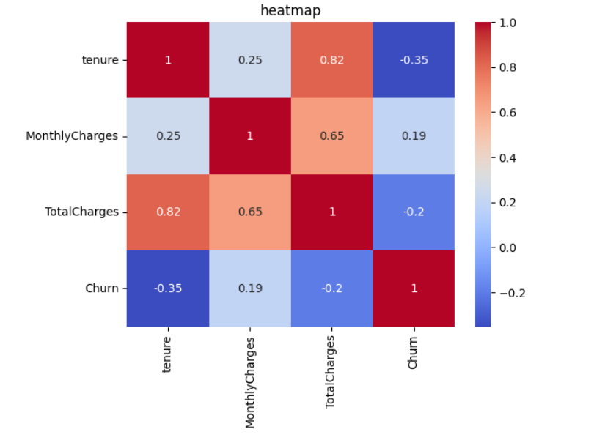
Heat Map

Slide 16
Tenure: Customers with very low tenure (0–10 months) show the highest churn, indicating that new customers are more likely to leave early if they are not satisfied with the service.
Monthly Charges: Higher monthly charge customers show relatively more churn, suggesting that expensive plans may push customers to switch to cheaper alternatives.
Total Charges: Customers with low total charges churn more, because they are usually new customers who have not stayed long with the company.

Slide 17
Data Cleaning and Outlier Detection
The dataset was first checked for missing and inconsistent values to ensure data quality before model building.
The variable TotalCharges was converted to numeric format and missing values were handled appropriately to avoid computation errors.
Outlier analysis was mainly performed on numerical variables such as Tenure, MonthlyCharges, and TotalCharges using visual methods (boxplots) and IQR approach.
No extreme or abnormal outliers were found that required removal, as the values were within realistic business ranges.
Data cleaning ensured that all features were consistent, valid, and suitable for machine learning models.

Slide 18
Data Preprocessing
Categorical variables were transformed into numerical format using label encoding techniques to make them suitable for machine learning models.
Numerical features were scaled using standardscaler to ensure uniform contribution during model training and to improve model performance.
The dataset was split into training and testing sets, and class imbalance in the target variable was handled using the SMOTE technique.

Slide 19
MODEL BUILDING
Notes:
MODEL BUILDING

Slide 20
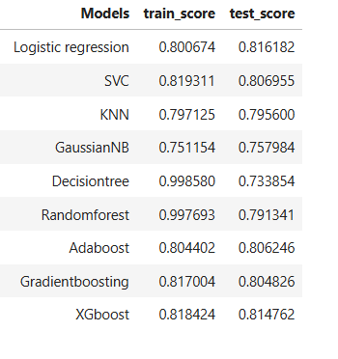

Slide 21
Multiple classification models were trained on the original dataset to establish baseline performance, including Logistic Regression, SVM, KNN, Naive Bayes, Decision Tree, Random Forest, AdaBoost, Gradient Boosting, and XGBoost.
Logistic Regression showed the most reliable performance with 0.81 accuracy, indicating good generalization and suitability for this dataset’s mostly linear and structured feature relationships.
Decision Tree and Random Forest showed overfitting behavior, as their extremely high training accuracy contrasted with noticeably lower test accuracy, indicating poor generalization despite strong training performance.

Slide 22
HANDLING CLASS IMBALANCE
Notes:
HANDLING CLASS IMBALANCE

Slide 23
The target variable exhibited a significant class imbalance, with non-churn customers (0 = 5,174) substantially exceeding churn customers (1 = 1,869), increasing the risk of biased model learning.
To address this issue, SMOTE (Synthetic Minority Over-sampling Technique) was applied exclusively to the training dataset to synthetically generate minority-class (churn) samples.
Post-balancing, the dataset achieved a fully balanced class distribution (0 = 4,138 and 1 = 4,138), ensuring equal representation of both churn and non-churn classes.
This step enhanced the model’s ability to capture churn patterns accurately, reduced prediction bias, and improved the overall robustness and generalization of the classification models.

Slide 24
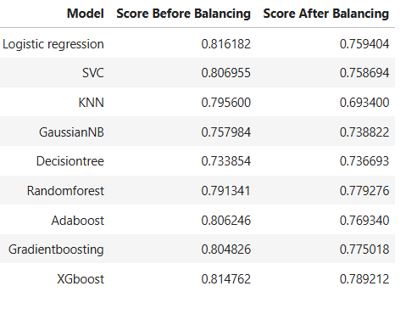

Slide 25
Although overall accuracy slightly decreased after balancing, the models became more reliable and fair, as churn customers were properly learned instead of being dominated by the majority (non-churn) class.
Balanced training shifted the models from biased majority-class prediction to a more realistic and generalizable churn prediction system, improving their ability to capture true churn behavior patterns.
This trade-off demonstrates that in churn prediction, model credibility and minority-class sensitivity are more important than raw accuracy, making the results more useful for business decision-making and retention strategies.

Slide 26
HYPERPARAMETER TUNING
Notes:
HYPERPARAMETER TUNING

Slide 27
GridSearchCV with cross-validation was employed to systematically tune critical hyperparameters (such as number of estimators, learning rate, and tree depth), enabling better control over model complexity and reducing overfitting.
After tuning, XGBoost and Random Forest exhibited improved balance between training and testing performance, demonstrating enhanced stability and generalization compared to their default configurations.
The final model was selected based on test accuracy and consistency, ensuring a robust and reliable churn prediction system suitable for real-world decision-making and customer retention strategies.

Slide 28
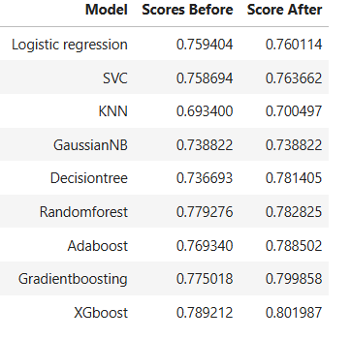
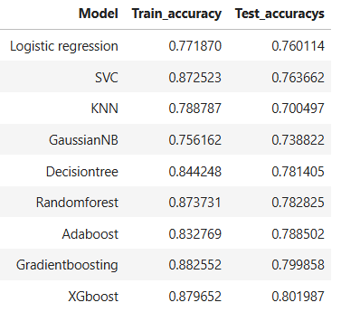

Slide 29
Hyperparameter tuning reduced overfitting by regulating model complexity (such as tree depth, learning rate, and number of estimators), resulting in a closer match between training and testing accuracy.
Generalization performance improved after tuning, as models demonstrated more stable and reliable predictions on unseen customer data.
Boosting-based models, particularly XGBoost, showed the greatest improvement, indicating that optimized parameters help capture complex churn patterns more effectively than default configurations.
Overall model accuracy increased across most classifiers, confirming that hyperparameter optimization is essential for building a robust and high-performing churn prediction model.

Slide 30
KEY FINDINGS
After hyperparameter tuning, all models showed improved performance, confirming the importance of optimization in churn prediction.
Among all classifiers, XGBoost achieved the highest test accuracy (~80%), indicating superior ability to capture complex customer behavior patterns.
Ensemble models (XGBoost, Gradient Boosting, Random Forest) consistently outperformed traditional models like Logistic Regression and KNN.
XGBoost was selected as the final model due to its best balance between training accuracy and test accuracy (reduced overfitting).
This final model can be effectively used to identify high-risk churn customers for targeted retention strategies.

Slide 31
FUTURE SCOPE
The model can be enhanced by incorporating real-time customer usage data to enable continuous and dynamic churn prediction.
Advanced techniques such as deep learning models (ANN, LSTM) can be explored to capture complex customer behavior patterns more effectively.
Additional features like customer feedback, complaint history, and service quality metrics can be integrated to improve prediction accuracy.
The churn prediction system can be deployed as a web-based or dashboard application for use by telecom customer relationship management (CRM) teams.
The model can be extended to perform customer segmentation, enabling personalized retention strategies for different customer groups.

Slide 32
CONCLUSION
The analysis shows that customers with short tenure, high monthly charges, and no long-term contracts have the highest probability of churn, indicating the need for early engagement strategies.
Customers using month-to-month plans and electronic check payments are more likely to leave; shifting them toward long-term contracts and auto-payment methods can improve retention.
Lack of value-added services (Online Security, Tech Support, Streaming) increases churn risk; offering bundled service packages and personalized add-ons can strengthen customer loyalty.
Customers with fiber optic internet and high bills show higher churn due to perceived cost; introducing discount plans or loyalty rewards for high-paying users can reduce dissatisfaction.
The final optimized model (XGBoost) enables early churn prediction, allowing the company to take proactive retention actions such as targeted offers, customer support calls, and customized plans.

Slide 33
Tools and technologies used:
Python,Pandas,Numpy,Matplotlib,Seaborn,Scikit-learn,Jupyter Notebook
References:
Kaggle,Research articles

Slide 34
THANK YOU
Notes:
THANK YOU

